Slide 1
Application of multi-particle techniques for flow analyses in CBM at FAIR
Ante Bilandzic (for the CBM Collaboration) Technical University of Munich “Workshop on analysis techniques for centrality determination and flow measurements at FAIR and NICA”, 27/08/2020

Slide 2
Outline
Introduction
Cornerstones of flow analyses with correlation techniques
Critical checks for CBM
For technical details on multi-particle correlations, see my talk from yesterday (http://indico.oris.mephi.ru/event/181/session/2/contribution/9)
Analysis code, dataset and cuts
Results
Control histograms
Acceptance corrections
Multi-particle correlations and cumulants vs. multiplicity
Coming next

Slide 3
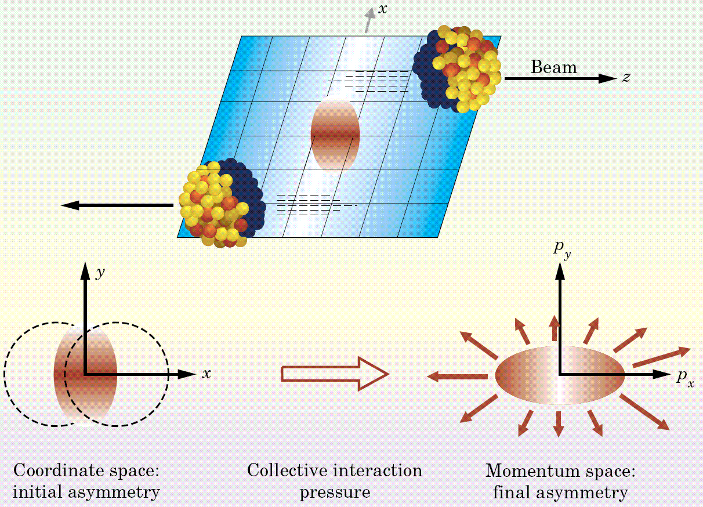
Anisotropic flow phenomenon
Transfer of anisotropy from the initial coordinate space into the final momentum space via the thermalized medium:
J.Y. Ollitrault, Phys. Rev. D 46 (1992) 229

Slide 4
Quantifying anisotropic flow with Fourier series
In the context of flow analysis, we use the 2nd parameterization to describe the anisotropic emission of particles in the transverse plane after heavy-ion collision:
$v_{n}$ : flow amplitudes
$Ψ_{n}$ : symmetry planes
Anisotropic flow is quantified with $v_{n}$ and $Ψ_{n}$
$v_{1}$ is directed flow
$v_{2}$ is elliptic flow
$v_{3}$ is triangular flow
$v_{4}$ is quadrangular flow, etc.
S. Voloshin and Y. Zhang, Z.Phys. C70 (1996) 665-672 (700+ citations!)

Slide 5
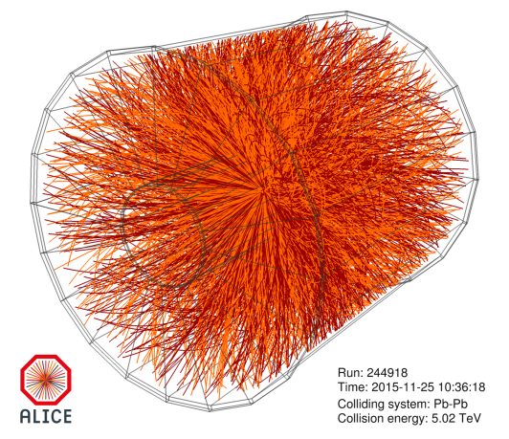
Cornerstones of flow analyses with correlation techniques
1. The analytic expression between azimuthal correlators and flow degrees of freedom
R. S. Bhalerao, M. Luzum and J.-Y. Ollitrault, PRC 84 034910 (2011)
A plethora of non-trivial and independent flow observables!
We need as many independent observables as possible to describe such a complex system as heavy-ion collision

Slide 6
Cornerstones of flow analyses with correlation techniques
2. Specific azimuthal correlators can be selected to correspond to different flow moments (this way we can constrain the underlying p.d.f. of flow fluctuations!)
Example:
Different flow moments carry by definition independent information about the underlying p.d.f. f($v_{n}$)

Slide 7
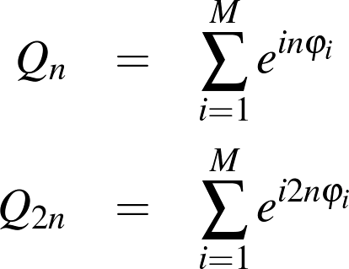
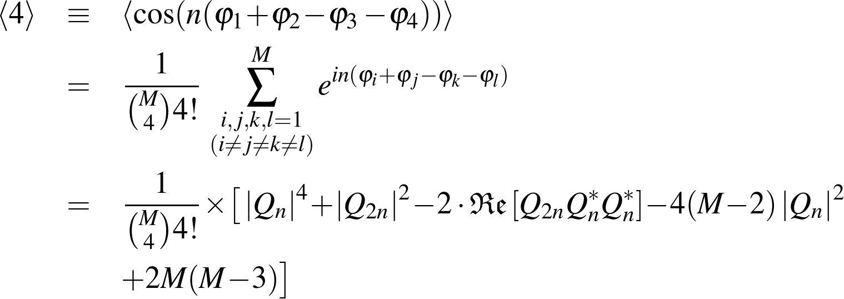
Cornerstones of flow analyses with correlation techniques
3. All multi-particle azimuthal correlators can be expressed analytically in terms of Q-vectors => self-correlations can be removed completely with a single pass over all azimuthal angles
Example: Analytic result for 4-p correlation

Slide 8
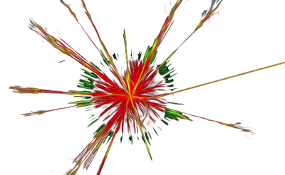
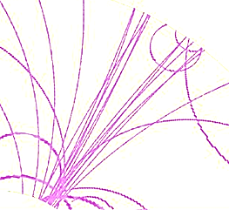
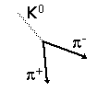
Cornerstones of flow analyses with correlation techniques
4. Multi-particle cumulants are less sensitive to nonflow than the corresponding multiparticle correlators, and therefore provide much more reliable estimates for anisotropic flow observables
resonance decays
jets
track splitting during
reconstruction

Slide 9
References
For the material presented in this talk, the relevant publications on multi-particle correlation techniques are:
Q-cumulants (Bilandzic et al, Phys. Rev. C 83 (2011) 044913)
First analytic expressions for few selected multiparticle correlations
Generic framework (Bilandzic et al, Phys. Rev. C 89 (2014) no.6, 064904)
Analytic expressions for ALL multiparticle correlations
Prescription to correct systematic biases due to detector inefficiencies
New flow observables: Symmetric Cumulants (SC)
These two publications contain all technical details, currently being implemented for CBM

Slide 10
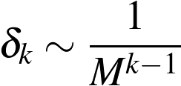
Critical check for CBM #1
Scaling of statistical uncertainty (N is number of events, M is multiplicity, v is flow strength, k is order of correlator):
Nonflow scaling:
For both reasons, multi-particle correlations is a precision technique only for: a) large multiplicities, b) large flow

Slide 11
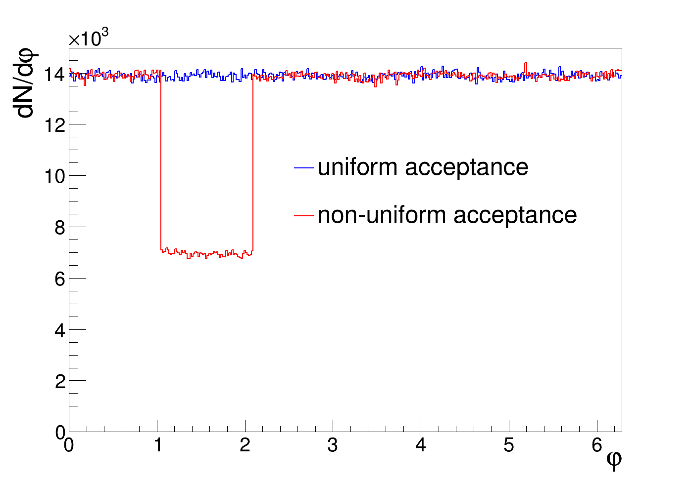
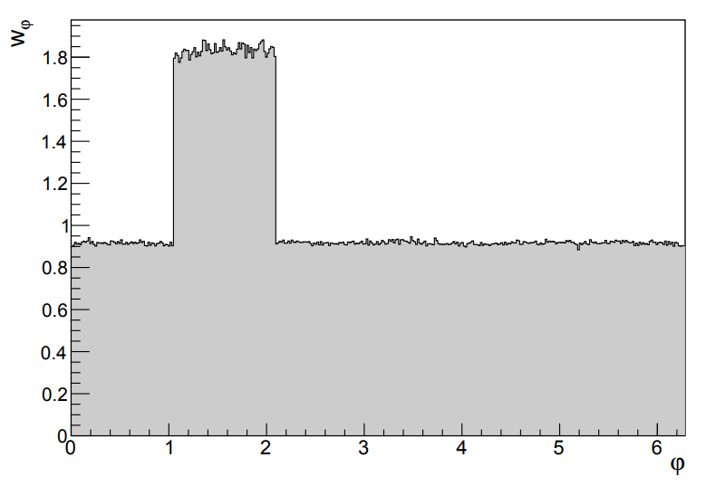
Critical check for CBM #2
Efficiency framework works as long as:
Particle weights can be built
Detector conditions are stable within each data-taking period (run), but can vary from one run to another
Section IV in Phys. Rev. C 89 (2014) no.6, 064904

Slide 12
Analysis code, dataset and cuts

Slide 13
Data format and file reader
/home/abilandz/CBM/development/macrosFromViktor/analysis_tree_simple.C
/home/abilandz/CBM/development/macrosFromViktor/analysis_tree_simple.C
AnalysesTree format downloaded and compiled locally:
https://git.cbm.gsi.de/pwg-c2f/data/analysis_tree
Compiled libraries can be loaded in ROOT 6 as:
gSystem->Load("/usr/local/lib/libAnalysisTreeBase.so")
gSystem->Load("/usr/local/lib/libAnalysisTreeCuts.so")
As a starting point, I am taking file readers from Viktor: /lustre/cbm/users/klochkov/sand_box/analysis_tree_test/analysis_tree_simple.C
https://git.cbm.gsi.de/pwg-c2f/data/analysis_tree/-/blob/master/examples/example.cpp
Many thanks to Viktor, Ilya and all other developers for help!

Slide 14
Analysis source code
/home/abilandz/CBM/development/macrosFromViktor/analysis_tree_simple.C
/home/abilandz/CBM/development/macrosFromViktor/analysis_tree_simple.C
At the moment, the code is in the private GitLab repository:
https://gitlab.com/abilandz/MultiparticleCorrelations
Eventually it will be ported to the central Git repository
The analysis code currently contains:
Main class: FlowWithMultiparticleCorrelations.{h,cxx}
Macros:
libraries.C
run.C
mergeAndBootstrap.C
makeWeights.C
makeNonDefaultPDFs.C
In the rest of the talk, demonstrating what the code can do with realistic and toy Monte Carlo studies

Slide 15
Datasets and cuts
/home/abilandz/CBM/development/macrosFromViktor/analysis_tree_simple.C
/home/abilandz/CBM/development/macrosFromViktor/analysis_tree_simple.C
Realistic distributions were obtained from common Monte Carlo production with CBMROOT OCT19 release:
OCT19, UrQMD + PLUTO, GEANT3, Au+Au@12, PSD
https://cbm-wiki.gsi.de/foswiki/bin/view/PWG/CommonMCproduction
Very basic cuts applied:
Rejecting all events with less than 8 particles
Selecting only particles with 0.0 < p_{T} < 5.0 GeV
All vertex components in [-10,10] cm
Final statistics: 4.06 M events

Slide 16
Results: Control Histograms

Slide 17
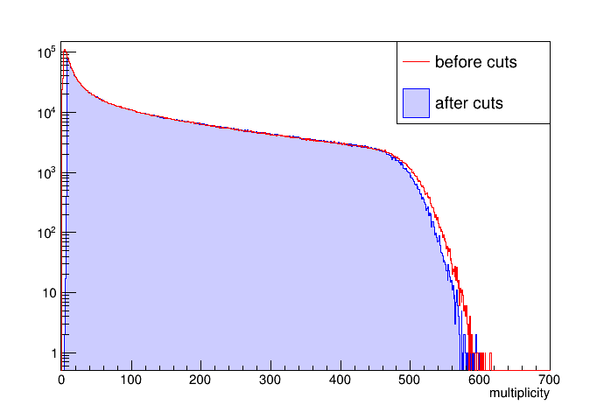
Multiplicity distribution
Cut on large p_{T} removes high-multiplicity events

Slide 18
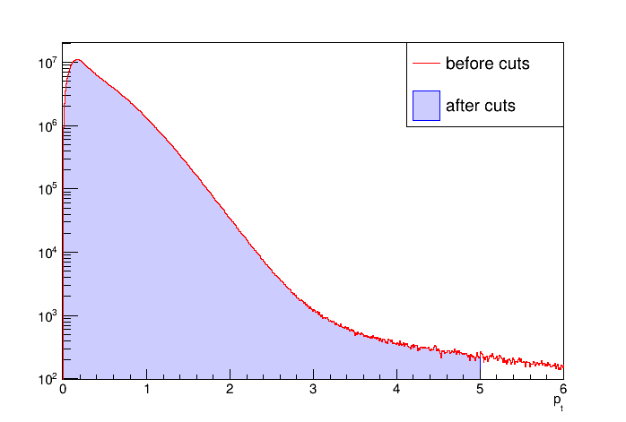
p_{T} distribution
This cut needs to be optimized for flow studies:
all flow harmonics exhibit non-trivial p_{T} dependence
nonflow and efficiency also depend on p_{T}

Slide 19
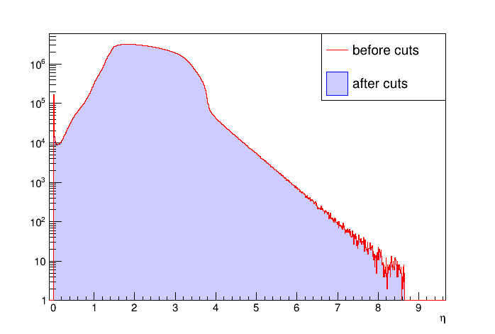
Pseudorapidity distribution
A large asymmetry: this has a consequence on all flow analysis techniques using Δη gaps to suppress short-range nonflow correlations
At CBM energies, rapidity is a better variable and will be used instead

Slide 20
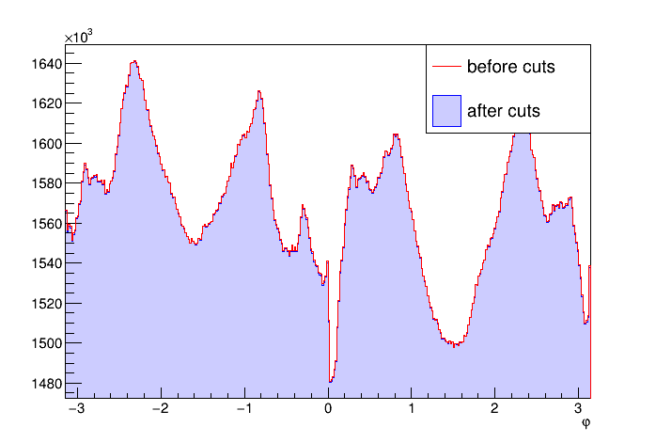
Azimuthal distribution
Large built-in anisotropies due to non-uniform azimuthal acceptance, this will be one the most dominant systematic biases in flow analyses at CBM with correlation techniques

Slide 21
Results: Acceptance corrections

Slide 22
Setup for Monte Carlo study
/home/abilandz/CBM/development/macrosFromViktor/analysis_tree_simple.C
/home/abilandz/CBM/development/macrosFromViktor/analysis_tree_simple.C
Question: If there are no input values of flow, what is the spurious built-in flow which corresponds to CBM’s non-uniform acceptance?
Can we correct for it?
Multiplicity, particle’s transverse momenta and pseudorapidity are sampled from realistic p.d.f.’s shown on previous slides
Particle azimuthal angles are taken for the analysis with probability which corresponds to p.d.f. resembling the CBM-like azimuthal acceptance
Estimating and correcting the effect of such non-uniform acceptance on each flow harmonic v_{n}

Slide 23
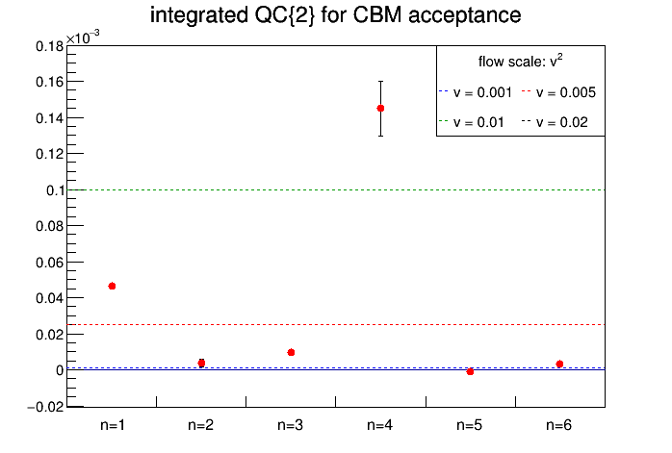
Results for spurious flow (1/6)
/home/abilandz/CBM/development/macrosFromViktor/analysis_tree_simple.C
/home/abilandz/CBM/development/macrosFromViktor/analysis_tree_simple.C
2-particle Q-cumulants, for CBM acceptance, for v₁ – v₆:
CBM’s non-uniform acceptance produces a spurious v₁ ~ 0.5% and v₄ ~ 1%
For all other flow harmonics, the effect is less than 0.5%

Slide 24
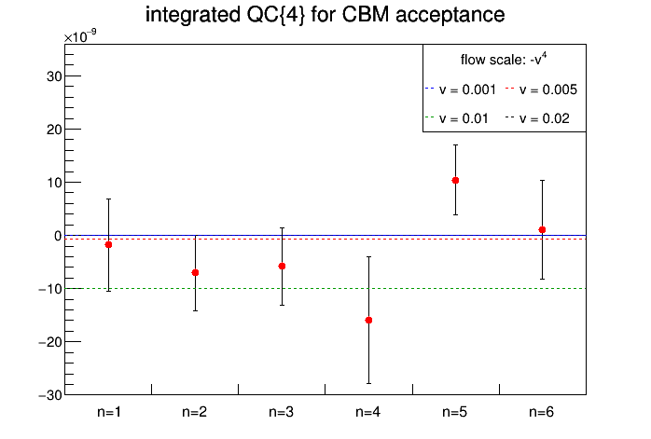
Results for spurious flow (2/6)
/home/abilandz/CBM/development/macrosFromViktor/analysis_tree_simple.C
/home/abilandz/CBM/development/macrosFromViktor/analysis_tree_simple.C
4-particle Q-cumulants, for CBM acceptance, for v₁ – v₆:
Statistical fluctuations are larger, but results are consistent with QC{2}

Slide 25
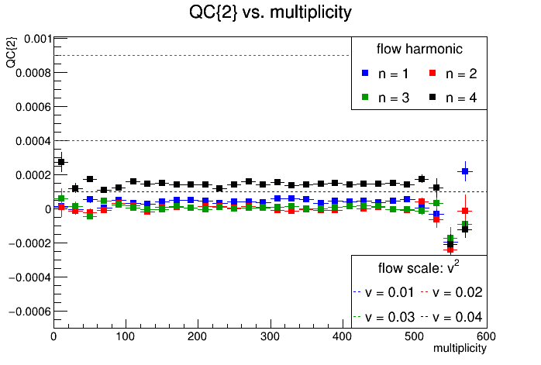
Results for spurious flow (3/6)
/home/abilandz/CBM/development/macrosFromViktor/analysis_tree_simple.C
/home/abilandz/CBM/development/macrosFromViktor/analysis_tree_simple.C
Differential 2-particle Q-cumulants vs. multiplicity, for CBM acceptance, for v₁ – v₄:

Slide 26
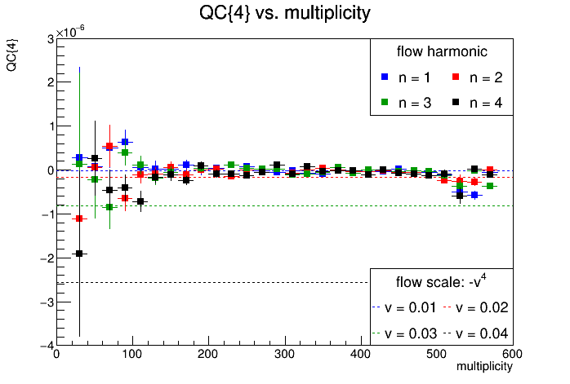
Results for spurious flow (4/6)
/home/abilandz/CBM/development/macrosFromViktor/analysis_tree_simple.C
/home/abilandz/CBM/development/macrosFromViktor/analysis_tree_simple.C
Differential 4-particle Q-cumulants vs. multiplicity, for CBM acceptance, for v₁ – v₄:

Slide 27
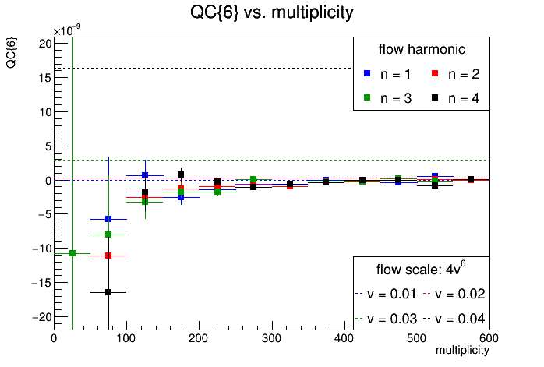
Results for spurious flow (5/6)
/home/abilandz/CBM/development/macrosFromViktor/analysis_tree_simple.C
/home/abilandz/CBM/development/macrosFromViktor/analysis_tree_simple.C
Differential 6-particle Q-cumulants vs. multiplicity, for CBM acceptance, for v₁ – v₄:

Slide 28
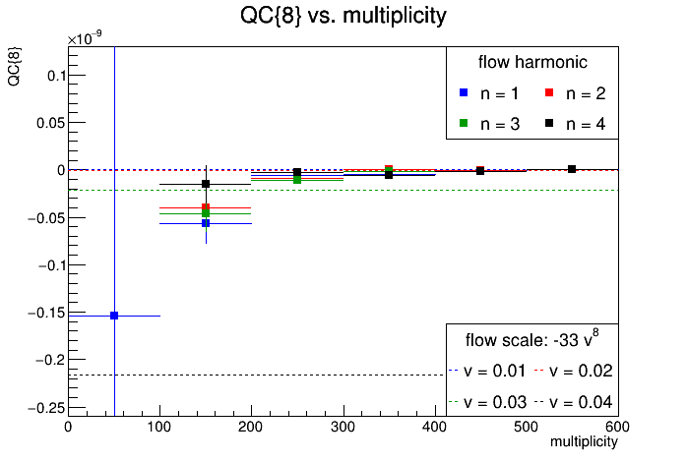
Results for spurious flow (6/6)
/home/abilandz/CBM/development/macrosFromViktor/analysis_tree_simple.C
/home/abilandz/CBM/development/macrosFromViktor/analysis_tree_simple.C
Differential 8-particle Q-cumulants vs. multiplicity, for CBM acceptance, for v₁ – v₄:

Slide 29
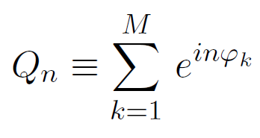
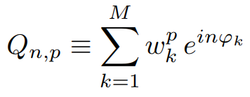
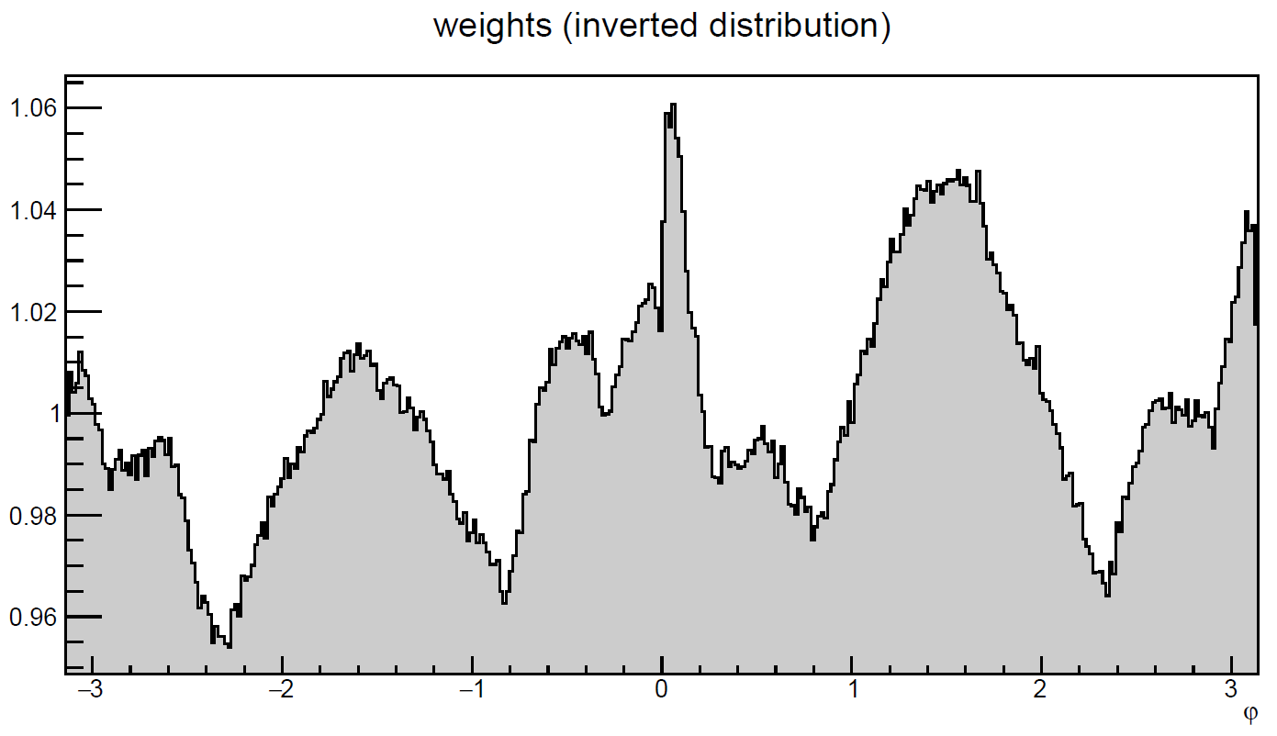
Correcting for spurious flow (1/2)
/home/abilandz/CBM/development/macrosFromViktor/analysis_tree_simple.C
/home/abilandz/CBM/development/macrosFromViktor/analysis_tree_simple.C
Non-uniform azimuthal distribution needs to be inverted, to obtain φ-weights
Rerun over the data and use φ-weights when building Q-vectors
Section IV in Phys. Rev. C 89 (2014) no.6, 064904

Slide 30
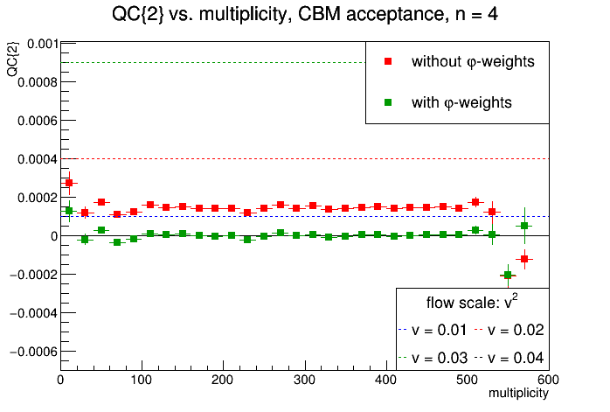
Correcting for spurious flow (2/2)
/home/abilandz/CBM/development/macrosFromViktor/analysis_tree_simple.C
/home/abilandz/CBM/development/macrosFromViktor/analysis_tree_simple.C
Effects of non-uniform azimuthal acceptance in CBM are largest for v₄
After applying φ-weights, all results are consistent with 0!

Slide 31
Results: Multi-particle correlations and cumulants vs. multiplicity

Slide 32
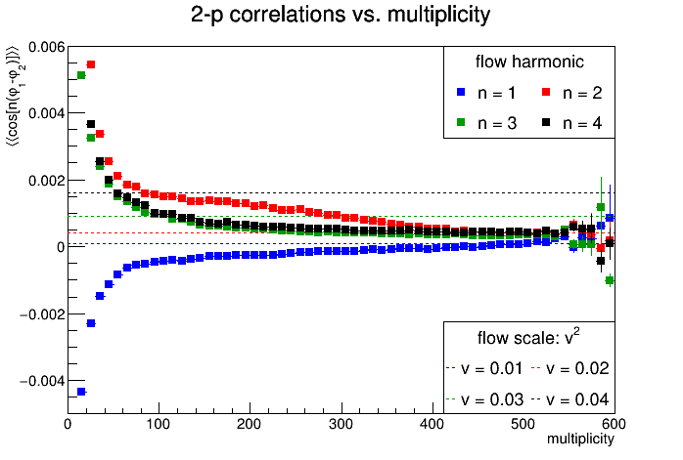
2-particle correlations vs. multiplicity
Estimate: $v_{1}^{2}$(blue), $v_{2}^{2}$ (red), $v_{3}^{2}$ (green), $v_{4}^{2}$ (black)

Slide 33
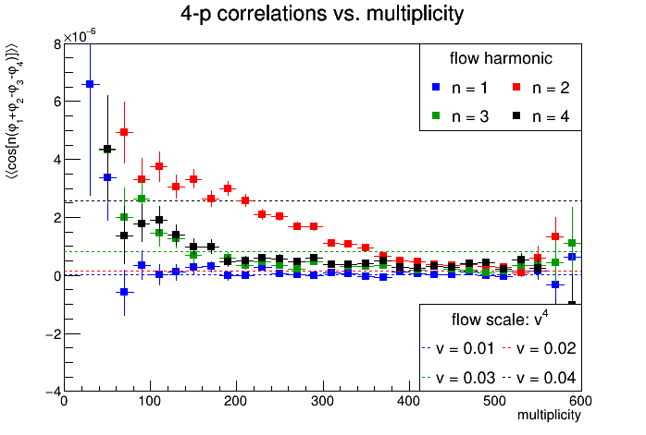
4-particle correlations vs. multiplicity
Estimate: $v_{1}^{4}$ (blue), $v_{2}^{4}$ (red), $v_{3}^{4}$ (green), $v_{4}^{4}$ (black)

Slide 34
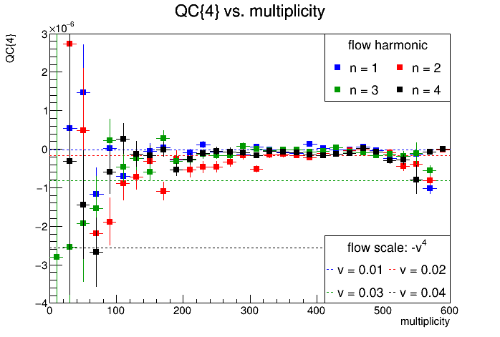
4-particle Q-cumulants vs. multiplicity
Estimate: -$v_{1}^{4}$ (blue), -$v_{2}^{4}$ (red), -$v_{3}^{4}$ (green), -$v_{4}^{4}$ (black)

Slide 35
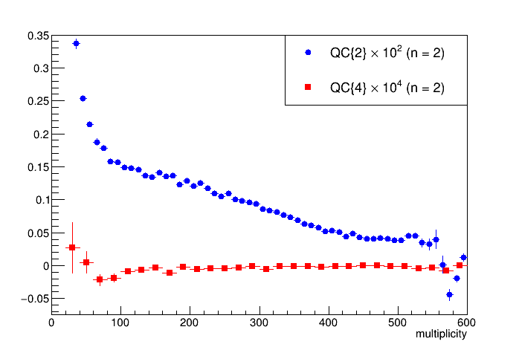
2-and 4-p cumulants at the same scale
Estimate: $v_{2}^{2}⨯{10}^{2}$(blue), -$v_{2}^{4}⨯{10}^{4}$ (red)

Slide 36
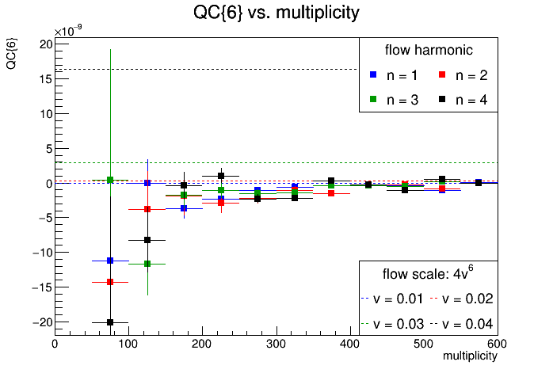
6-particle Q-cumulants vs. multiplicity
Estimate: 4$v_{1}^{6}$ (blue), 4$v_{2}^{6}$ (red), 4$v_{3}^{6}$ (green), 4$v_{4}^{6}$ (black)

Slide 37
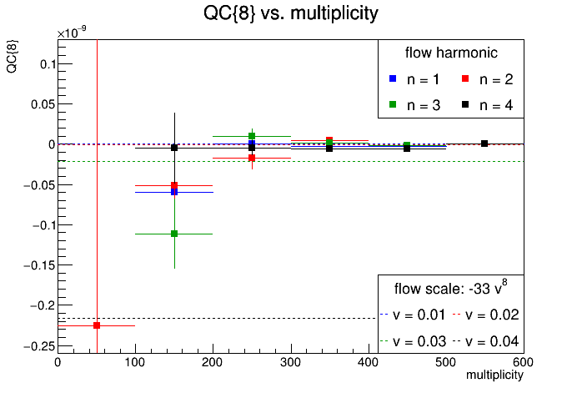
8-particle Q-cumulants vs. multiplicity
Estimate: -33$v_{1}^{8}$ (blue), -33$v_{2}^{8}$ (red), -33$v_{3}^{8}$ (green), -33$v_{4}^{8}$ (black)

Slide 38
Coming next
Monte Carlo studies with other particle weights (transverse momentum and pseudorapidity)
Run analysis using MC-true particles and compare with results at the reconstruction level
PID techniques and switch from pseudorapidity to rapidity
Moving the analysis code to the central Git repository
Extending and optimizing event, track and PID selection criteria for CBM energies
Adding the interface for centrality determination
Implementing other multi-particle observables in flow analyses
Symmetric cumulants (SC)
Symmetry plane correlations
...

Slide 39
Thanks!

Slide 40
Backup slides

Slide 41
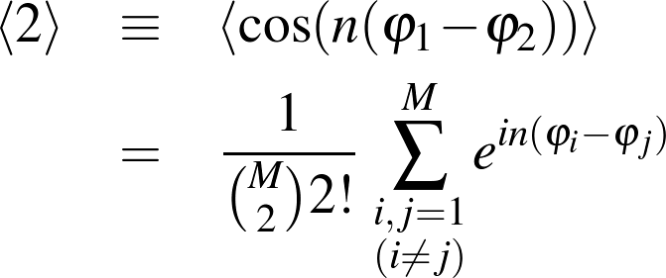
Multiparticle correlation techniques
Technical problem which plagued this field for decade: How to remove self-correlations?
Formalism of generating functions developed by Ollitrault et al and used at RHIC is only approximate
For data analysis at LHC we have prepared something better...

Slide 42
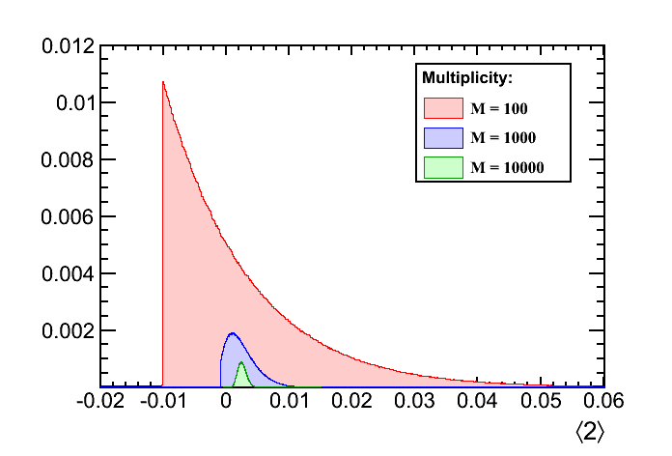
Multiparticle correlation techniques
Monte Carlo study, fixed v = 0.05 as an input:

Slide 43
The essence of the idea
Estimating flow harmonics with 2-particle correlation:
event
average
particle
average
The ‘trick’ works for any number of particles in the correlator
k-particle correlations estimate $v_{n}^{k}$
But in the real world, there are subtleties...
Trivial self-correlations
Other sources of physical correlations (‘nonflow’)
Detector artifacts

